Slide 1




Sales
Graduation project

Slide 2






Names of team
members
Ahmed Elfeel
Zyad Elkholy
Saied Gamal
Elsayed Osama
Mohamed
Mahrous

Slide 3


Introduction
This data includes a set of tables to analyze sales and product performance across distributors, allowing me to identify the most profitable channels and top-selling geographies, as well as understand customer preferences. The analysis also helps me improve pricing and distribution strategies, reduce returns by improving customer experience, and increase supply chain efficiency.

Slide 4
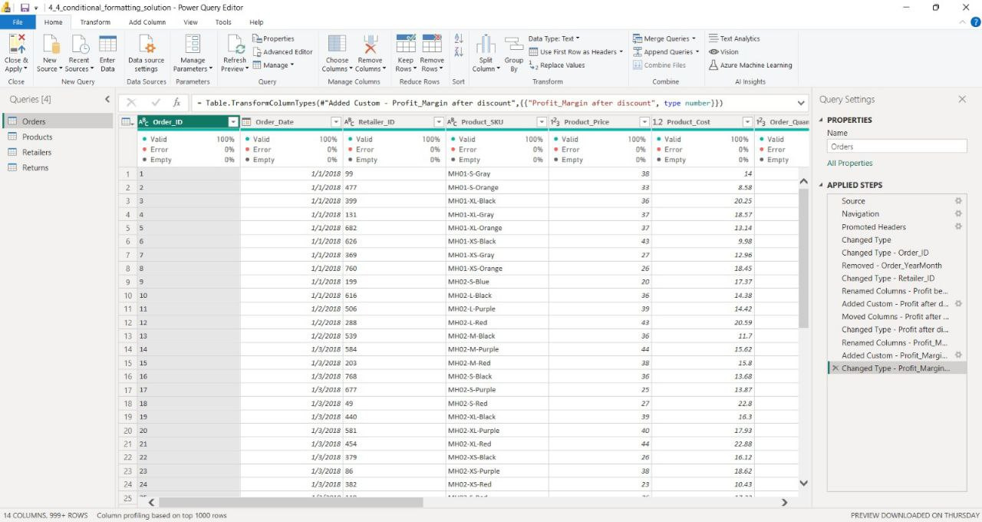
Data transformation

Slide 5
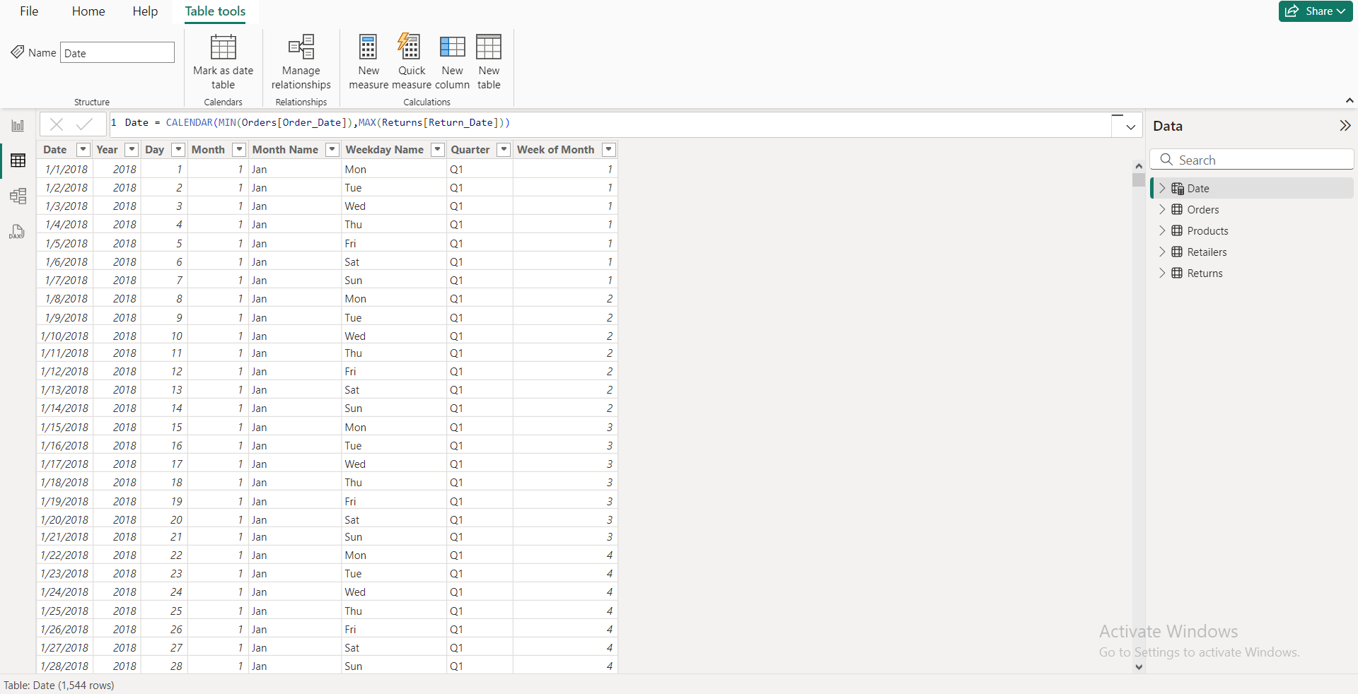
Date Tabels

Slide 6
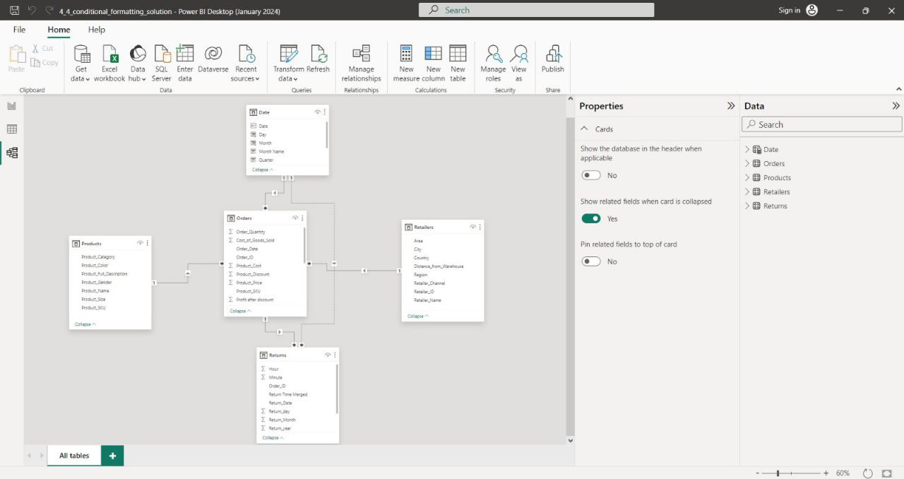
Data Modeling

Slide 7

Question
The analysis aims to answer questions about the most profitable channels, best performing geographies, return rate, best-selling products, and the impact of discounts, with the aim of improving pricing strategies, increasing efficiency, and reducing returns.

Slide 8
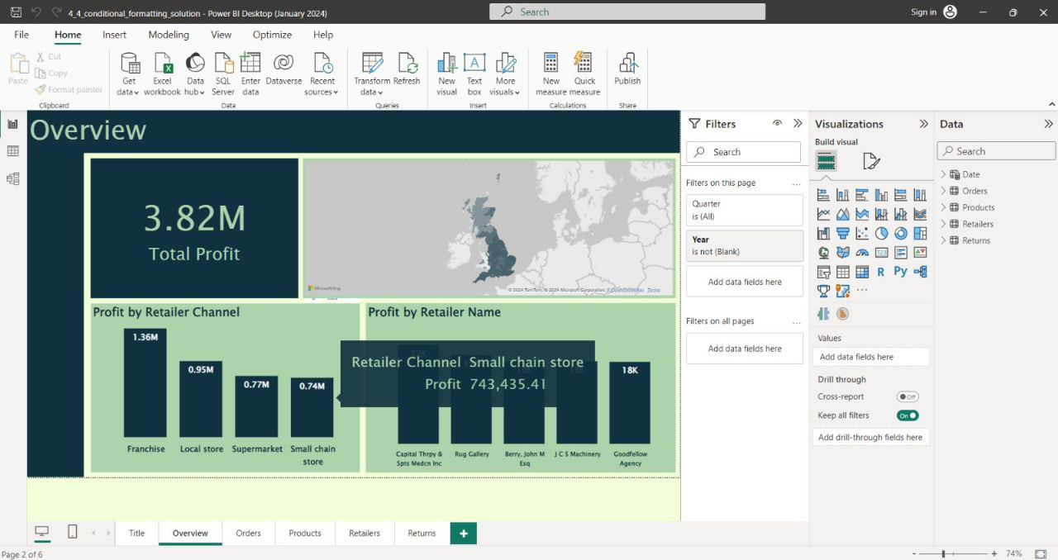
visualization

Slide 9
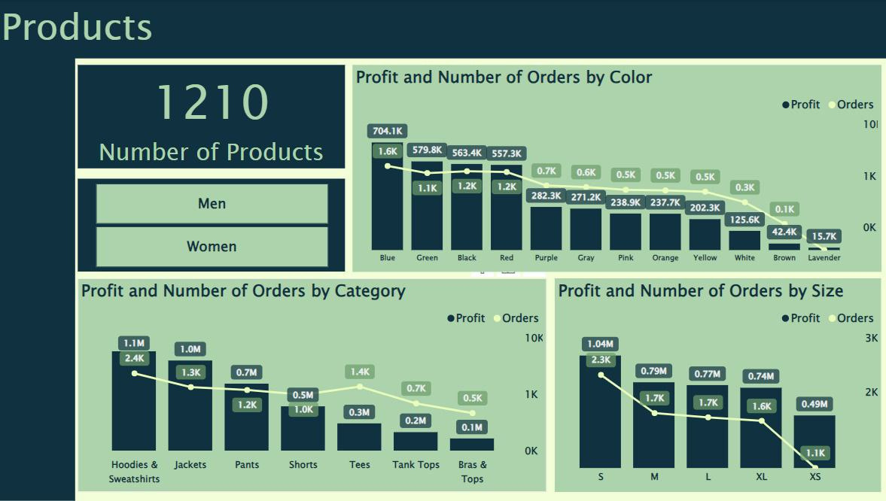
visualization

Slide 10
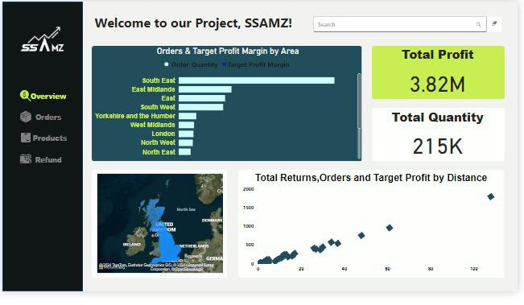
Ui/UX

Slide 11
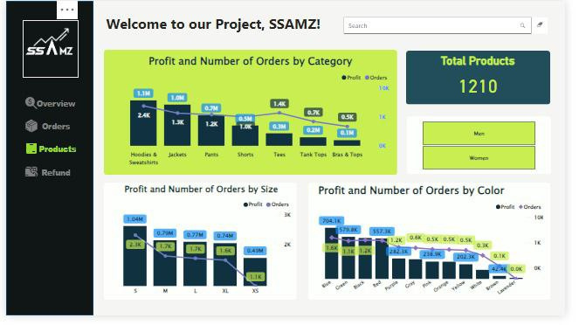
Ui/UX

Slide 12







Phone
Let's work together
+2010########
Email
############@gmail.com
Contact

Slide 13

See you soon

